Slide 1
Cyclistic Case study Project
Created By: Kyle Johnson
Date: 08/11/2024

Slide 2
Introduction
Cyclistic is a fictitious company that runs a bike share program in a major metropolitan area
There are 2 types of customers that use Cyclistic
Members – paying an annual membership fee
Casual Riders – paying as they use Cyclistic bikes
The Finance Team has found that annual members are much more profitable than casual riders
The Analytics Team was tasked with evaluating the differences in behavior between members and casual riders to identify trends
Note: Since Cyclistic is not a real company, data was used from the Divvy bikeshare database. It was retrieved and used under this license.

Slide 3
Main objective
The main goal of this project is to design a marketing campaign to target casual riders and convert them to annual members
There are 3 guiding questions that serve to guide this project:
How to annual members and casual riders use Cyclistic bikes differently?
Why would casual riders buy Cyclistic annual memberships?
How can Cyclistic use digital media to influence casual riders to become members?
The analysis team will do the following:
Answer the first question above – How do annual and casual riders behave differently?
Provide recommendations based on findings

Slide 4
THE Data
This data is from the Divvy bikeshare company based in Chicago, IL
The raw data is .csv files for each month from July 2023 through June 2024
In total there are about 5.7MM individual data points
Each data point includes date, start/end time, start/end location, bike type, membership type, and sometimes the start/end station
It was cleaned, transformed, analyzed, visualized, and presented using a combination of Excel, SQL (BigQuery), and PowerPoint

Slide 5
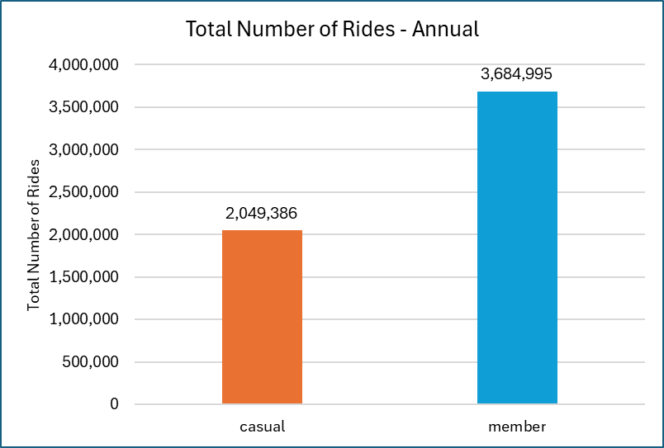
Key Insights - Annual
Members are 64.3% of total rides

Slide 6
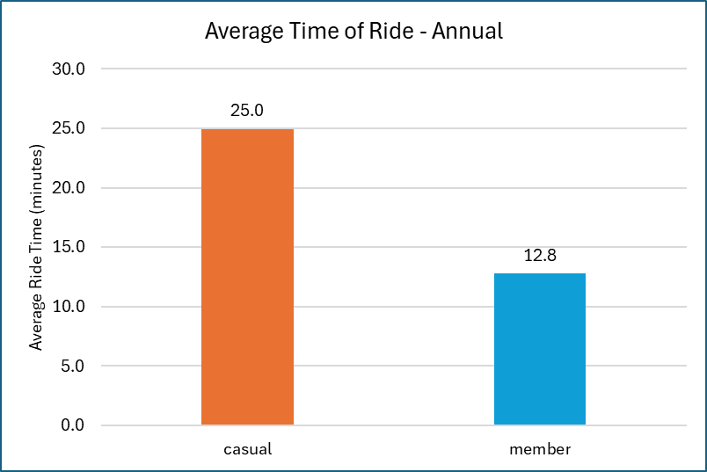
Key Insights - Annual
Casual riders spend about 2x more time on each ride

Slide 7
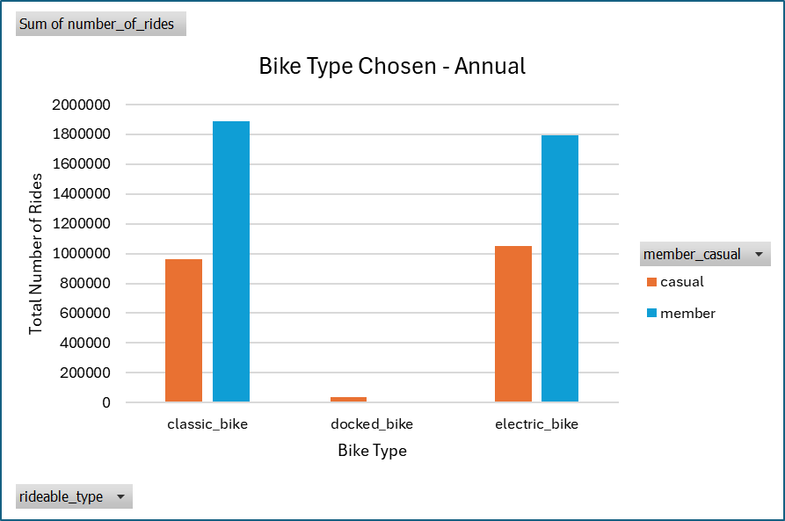
Key Insights - Annual
Members slightly prefer classic bikes
Casual riders slightly prefer electric bikes

Slide 8
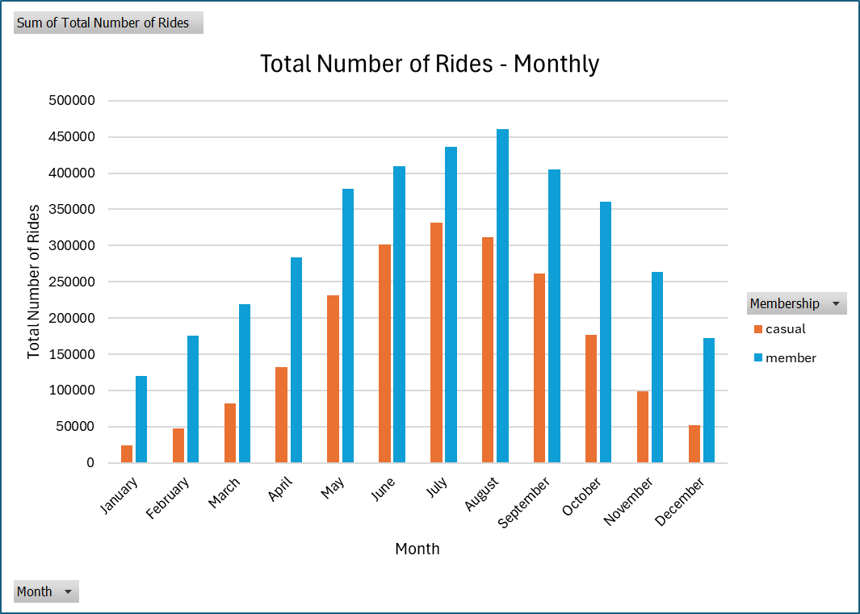
Key Insights - monthly
Total ridership is seasonal
Peaking in August for members
Peaking in July for casual riders

Slide 9
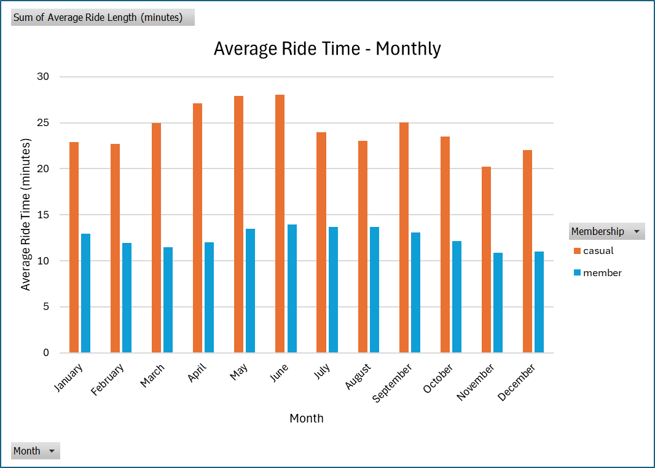
Key Insights - monthly
Average ride time does not seem to be seasonally dependent
Members are fairly consistent throughout the year
Casual riders may have a slight seasonality in their ride time

Slide 10
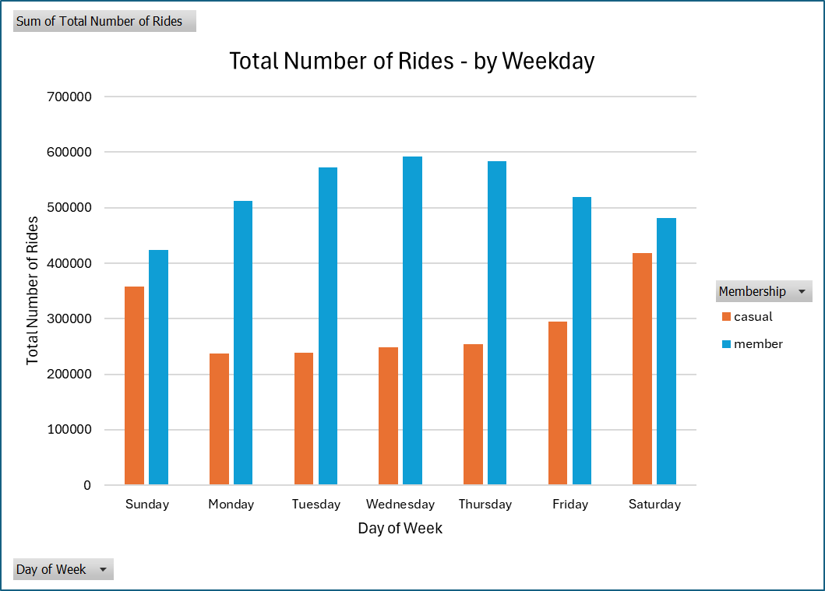
Key Insights – day of week
Members typically ride Monday-Friday
Casual riders typically ride Saturday-Sunday

Slide 11
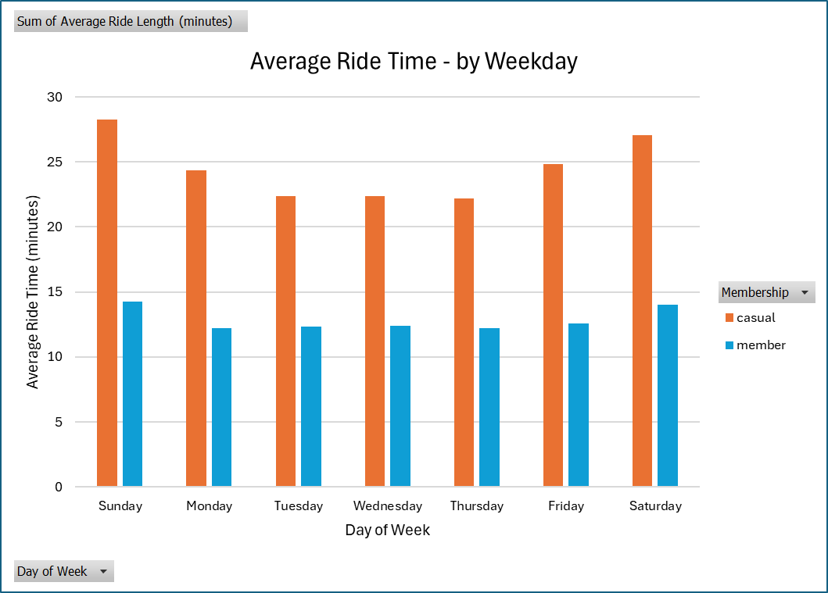
Key Insights – day of week
Members ride time is more consistent, peaking on Saturday-Sunday
Casual riders ride time varies more, peaking on Saturday-Sunday

Slide 12
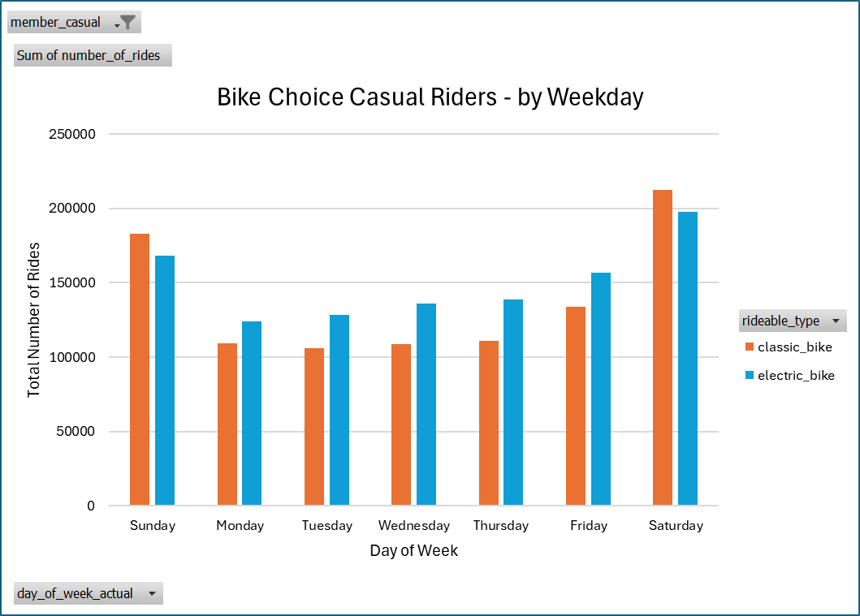
Key Insights – day of week
Casual riders typically prefer e-bikes Monday-Friday
Casual riders typically prefer classic bikes Saturday-Sunday
Members always prefer classic bikes, regardless of day of the week

Slide 13
Conclusion
Annual members and casual riders do have different behaviors and preferences
The following are some of the key differences between annual members and casual riders:
Casual riders rode for about 2x the time as members on an average ride
Casual riders prefer to ride on weekends, annual members prefer to ride during the weekdays
Casual riders prefer electric bikes, annual members prefer classic bikes
The following are some key similarities between annual members and casual riders:
Total rides peak during summer months, August for members and July for casual riders
Average ride time peaks during weekends

Slide 14
Recommendations (Next Steps)
Marketing team to develop strategy to target converting casual riders to annual members based on analysis.
Some possible ideas shown below:
Ads based on showing benefits and value of commuting to work using Cyclistic bikes
Free trial of membership
Partnering with local businesses located within metropolitan area
Finance team to explore pricing strategy
Can we make casual riders more profitable?
Data analysis team to explore data further, looking into:
Start/end locations, comparing members and casual riders
Create monthly report to track effectiveness of marketing campaign
Frequency of rides for members vs. casual riders (need more data)

Slide 15
Questions/Comments?

